Slide 1


Francisco Machado dos Santos
06/03/2023

Slide 2

Outline
Executive Summary
Introduction
Methodology
Results
Conclusion
Appendix

Slide 3
Executive Summary
In the IBM Data Science capstone project, we will predict if the SpaceX Falcon 9 first stage will land successfully or not. By doing this, we can determine the cost of a launch.
The methodology used to tackle this are the following:
Data Collection
Data Wrangling and Processing
Exploratory Data Analysis
Data Visualization and finally
Machine Learning Prediction.
The results of our analysis indicate that there are some features of rocket launches that can help dictate the success or failure of the rocket launches. Additionally, we conclude that the Decision Tree may be the best machine learning algorithm to solve this problem.

Slide 4
Introduction
The main goal of this capstone project was to predict if the Falcon 9 first stage will land successfully or not.
As most of us know, SpaceX prides itself in being able to reuse the first stage of a rocket launch so much so that they advertise on their website that their rocket launches cost 62 million while other provides cost upward 165 million. Much of these savings are down to the first stage's reusability. If we can determine if the first stage will land, we can determine the cost of a launch. This information can be used if an alternate company wants to bid against SpaceX for a rocket launch.
This brings us to our main question that we are trying to answer :
“For a given set of features about a Falcon 9 rocket launch, will the first stage of the rocket land successfully?”

Slide 5

Section 1

Slide 6
Methodology
Data was collected through two methods: requesting data from the SpaceX API and web scraping launch data from a Wikipedia page.
Data wrangling was then performed to transform and clean the data using Python's pandas library. With the clean data, exploratory data analysis (EDA) was performed using visualization tools such as Python's matplotlib and seaborn libraries, as well as answering questions using SQL queries.
Python’s interactive visualization packages were used to answer some analytical questions. Folium was used for creating maps while Plotly Dash was used to create interactive data visualizations.
Four different machine learning classification models were used for the predictive analysis. The models that were used are logistic regression, support vector machines, k-nearest neighbor and decision tree classifier. Each model was trained, tuned and evaluated to find the best one.

Slide 7
Data Collection – SpaceX API
1. Request and parse the SpaceX launch data using the GET request.
2. Normalize JSON response into a dataframe.
3. Extract only useful columns using auxiliary functions.
4. Create new pandas dataframe from dictionary.
5. Filter dataframe to only include Falcon 9 launches
6. Handle missing values.
7. Export to CSV file.
GitHub URL:

Slide 8
Data Collection - Scraping
1. Request rocket launch data from its Wikipedia page.
2. Extract column names from the HTML table header.
3. Create a dataframe by parsing the launch HTML tables.
4. Export to CSV file.
GitHub URL:

Slide 9
Data Wrangling
1. Calculate the number of launches in each site.
2. Calculate number and occurrence of each orbit.
3. Calculate the number and occurrence of mission outcome for each orbit type.
4. Create a landing outcome label from outcome column using one-hot encoding.
5. Export to CSV.
GitHub URL:

Slide 10
EDA with Data Visualization
Scatter plots: Scatter plots were used to represent the relationship between two variables. Different sets of features were compared such as Flight Number vs. Launch Site, Payload vs. Launch Site, Flight Number vs. Orbit Type and Payload vs. Orbit Type.
Bar chart: Bar charts were used makes it easy to compare values between multiple groups briefly. The x-axis represents a category, and the y-axis represents a discrete value. Bar charts were used to compare the Success Rate for different Orbit Types.
Line chart: Line charts are useful for showing data trends over time. A line chart was used to show Success Rate over a certain number of Years.
GitHub URL:

Slide 11
EDA with SQL
A list of some of the SQL queries performed on the dataset is listed below:
Displaying the names of the unique launch sites in the space mission; displaying 5 records where launch sites begin with the string 'CCA’; displaying the total payload mass carried by boosters launched by NASA (CRS); displaying average payload mass carried by booster version F9 v1.1.
Listing the date when the first successful landing outcome in ground pad was achieved; listing the names of the boosters which have success in drone ship and have payload mass greater than 4000 but less than 6000; listing the total number of successful and failure mission outcomes; listing the names of the booster versions which have carried the maximum payload mass; listing the failed landing outcomes in drone ship, their booster versions, and launch site names for in year 2015; ranking the count of landing outcomes between the date 2010-06-04 and 2017-03-20, in descending order.
GitHub URL:

Slide 12
Build an Interactive Map with Folium
Objects were created and added to a Folium map. Marker objects were used to show all launch sites on a map as well as the successful/failed launches for each site on the map. Line objects were used to calculate the distances between a launch site to its proximities.
By adding these objects, following geographical patterns about launch sites are found:
Are launch sites near railways? Yes.
Are launch sites near highways? Yes.
Are launch sites near coastline? Yes .
Do launch sites keep certain distance away from cities? Yes.
GitHub URL:

Slide 13
Build a Dashboard with Plotly Dash
The dashboard application contains two charts:
A pie chart that shows the successful launch by each site. This chart is useful as you can visualize the distribution of landing outcomes across all launch sites or show the success rate of launches on individual sites.
A scatter chart that shows the relationship between landing outcomes and the payload mass of different boosters. The dashboard takes two inputs, namely the site(s) and payload mass. This chart is useful as you can visualize how different variables affect the landing outcomes.
GitHub URL:

Slide 14
Predictive Analysis (Classification)
1. Create a columns for Class.
2. Standardize data.
3. Split into training and test set.
4. Find best Hyperparameter for SVM, Decision Trees, K-Nearest Neighbours and Logistic Regression.
5. Use test data to evaluate models based on their accuracy scores and confusion matrix.
GitHub URL:

Slide 15
Results
The results of the exploratory data analysis revealed that the success rate of the Falcon 9 landings was 66.66%.
The predictive analysis results showed that the Decision Tree algorithm was the best classification method with an accuracy of 94%.
GitHub URL:

Slide 16

Section 2

Slide 17
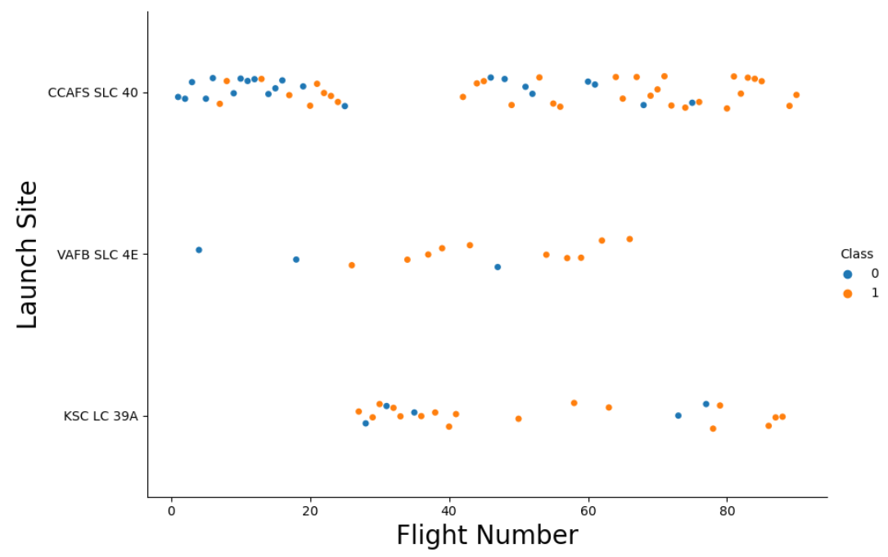
Flight Number vs. Launch Site
Observations:
This figure shows that the success rate increased as the number of flights increased.
The blue dots represent the successful launches. Red dot represent unsuccessful launches.
There seems to be an increase in successful flights after the 40th launch.

Slide 18
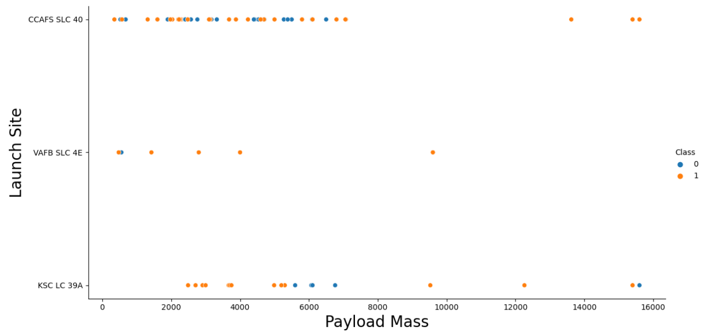
Payload vs. Launch Site
Observations:
The blue dots represent the successful launches. Red dots represent unsuccessful launches.
For the VAFB-SLC launch site there are no rockets launched for heavy payload mass.
There seems to be a weak correlation between Payload and Launch Site and therefore decisions cannot be made using this metric.

Slide 19
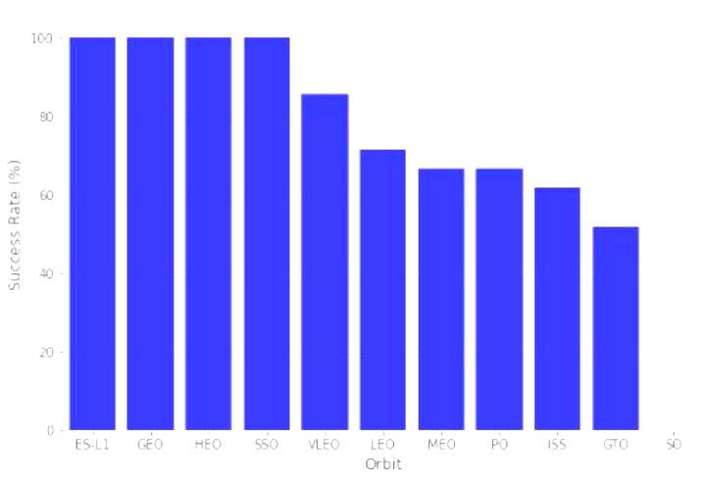
Success Rate vs. Orbit Type
Observations:
Orbits ES-L1, GEO, HEO and SSO have 100% success rates.
SO orbit did not have any successful launches with a 0% success rate.

Slide 20
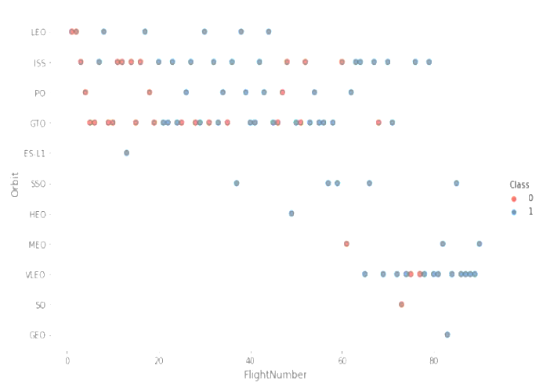
Flight Number vs. Orbit Type
Observations:
In the LEO orbit, the success is positively correlated to the number of flights.
There seems to be no relationship between flight number in the GTO orbit.
The SSO orbit has a 100% success rate however with fewer flights than the other orbits.
Flights numbers greater than 40 have a higher success rate than flight numbers between 0-40.

Slide 21
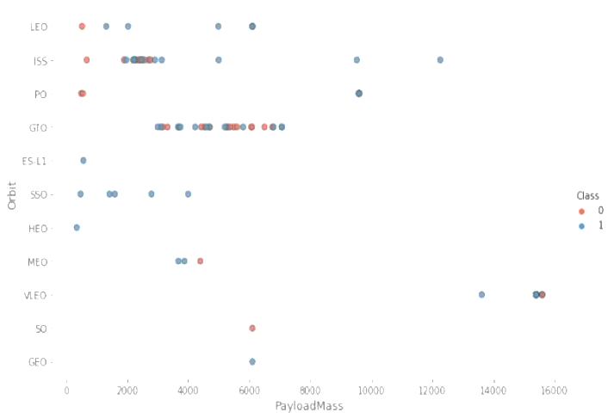
Payload vs. Orbit Type
Observations:
As the payloads get heavier, the success rate increases in the PO, SSO, LEO and ISS orbits.
There seems to be no direct correlation between orbit type and payload mass for GTO orbit as both successful and failed launches are equally present.

Slide 22
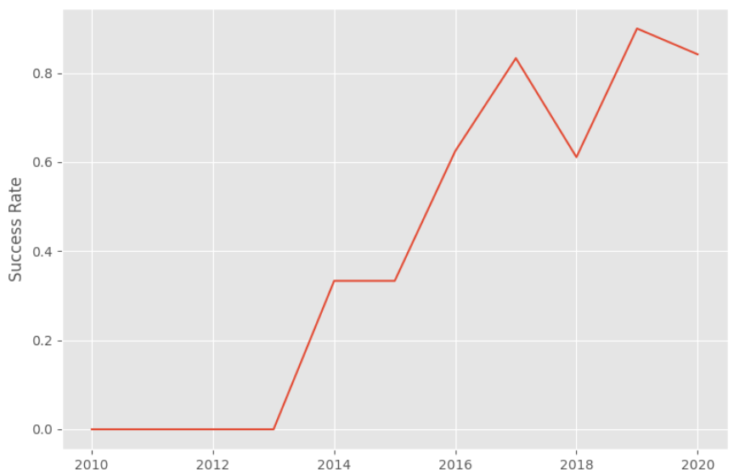
Launch Success Yearly Trend
Observations:
The general trend of the chart shows an increase in landing success rate as the years pass. There is however a dip in 2018 as well as in 2020.

Slide 23
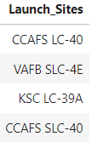
All Launch Site Names
The DISTINCT clause was used to return only the unique rows from the launch site column.
The names of the launch sites are CCAFS LC-40, CCAFS SLC-40, KSC LC-39A, VAFB SLC.

Slide 24
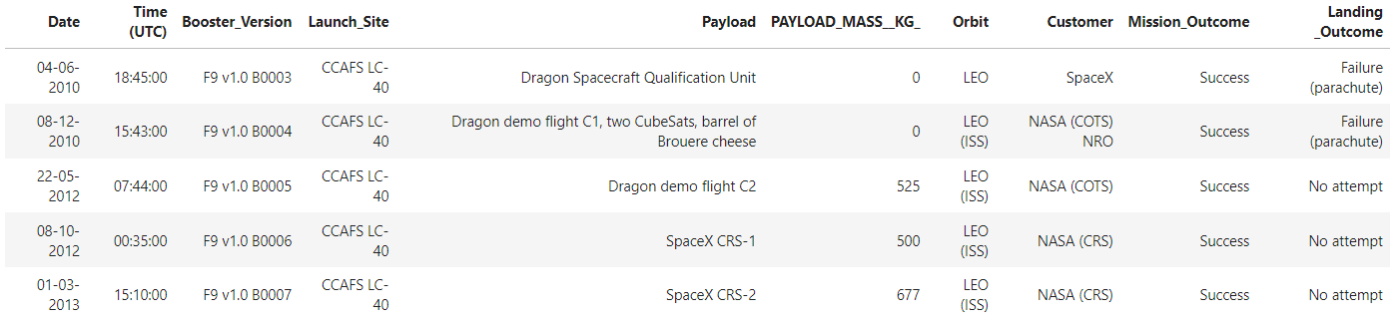
Launch Site Names Begin with 'CCA'
The LIMIT and LIKE clauses were used to display only the top five results where the launch site name starts with 'CCA’.

Slide 25
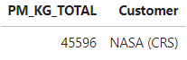
Total Payload Mass
The SUM() function was used to the calculate the total payload carried by boosters from NASA from the payload_mass__kg column.

Slide 26
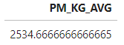
Average Payload Mass by F9 v1.1
The AVG() function was used to the calculate the average payload the average payload mass carried by booster version F9 v1.1.
The WHERE clause was used to filter results so that the calculations were only performed on booster versions only if they were named “F9 v1.1.

Slide 27
First Successful Ground Landing Date
The MIN(DATE) function was used to find the date of the first successful landing outcome on ground pad.
The WHERE clause ensured that the results were filtered to match only when the 'landing outcome' column is 'Success (ground pad).

Slide 28
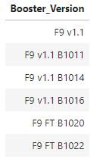
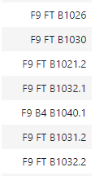
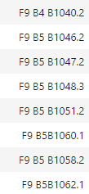
Successful Drone Ship Landing with Payload between 4000 and 6000
The BETWEEN clause was used to retrieve only those results of payload mass greater than 4000 but less than 6000.
The WHERE clause filtered the results to include only boosters which successfully landed on drone ship

Slide 29
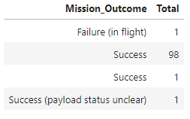
Total Number of Successful and Failure Mission Outcomes
The COUNT() function is used to count the number of occurrences of different mission outcomes with the help of the GROUP BY clause applied to the 'mission outcome' column. A list of the total number of successful and failure mission outcomes were returned.
There have been 98 successful mission outcomes out of 101 missions.

Slide 30
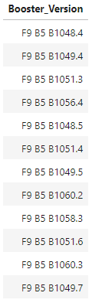
Boosters Carried Maximum Payload
The MAX() function was used in a subquery to retrieve a list of boosters which have carried the maximum payload mass.

Slide 31
2015 Launch Records
The SELECT statement was used to retrieve multiple columns from the table.
The YEAR(DATE) function was used to retrieve only those rows with a 2015 launch date.

Slide 32
Rank Landing Outcomes Between 2010-06-04 and 2017-03-20
The COUNT() function was used to count the different landing outcomes.
The WHERE and BETWEEN clauses filtered the results to only include results between 2010-06-04 and 2017-03-20.
The GROUP BY clause ensure that the counts were grouped by their outcome.
The ORDER BY and DESC clauses were used to sort the results by descending order.

Slide 33

Section 3

Slide 34
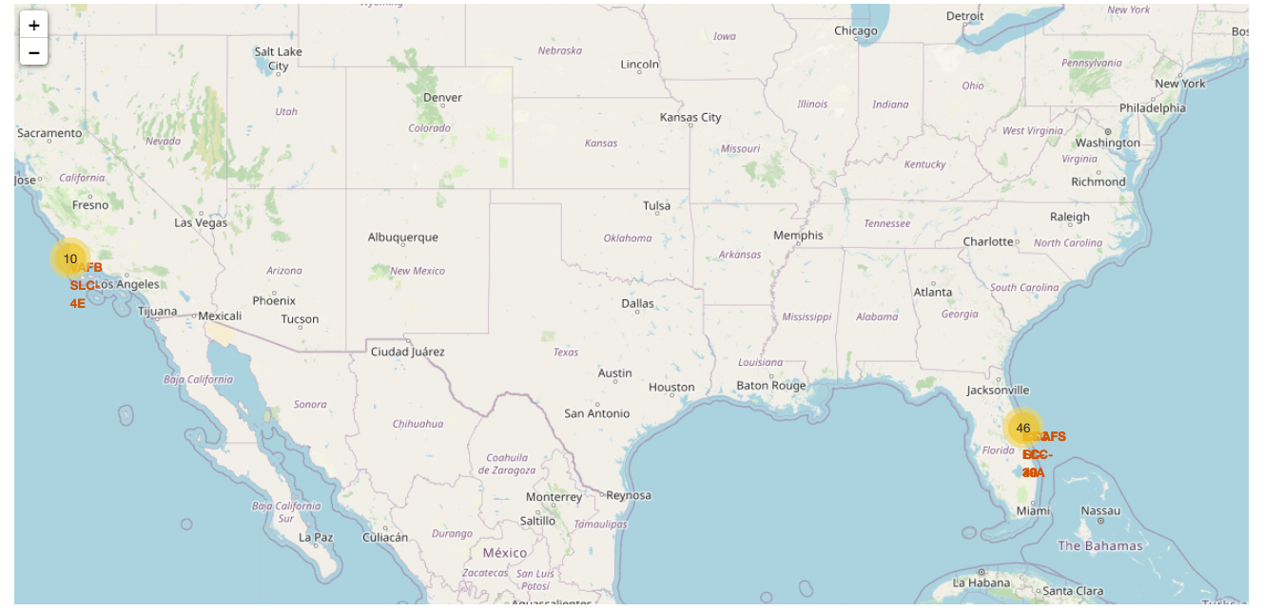
SpaceX Launch Sites Location
Observations:
The yellow markers are indicators of where the locations of all the SpaceX launch sites are situated in the US.
The launch sites have been strategically placed near the coast.

Slide 35
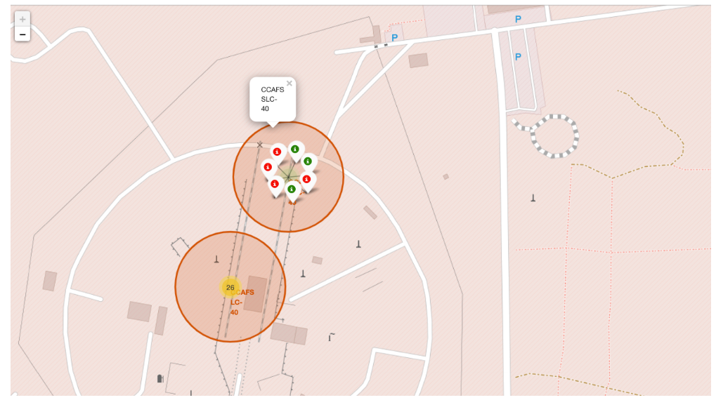
Success and Failure Landings
Observations:
Successful landings are marked in green and failure landings are marked in red.

Slide 36
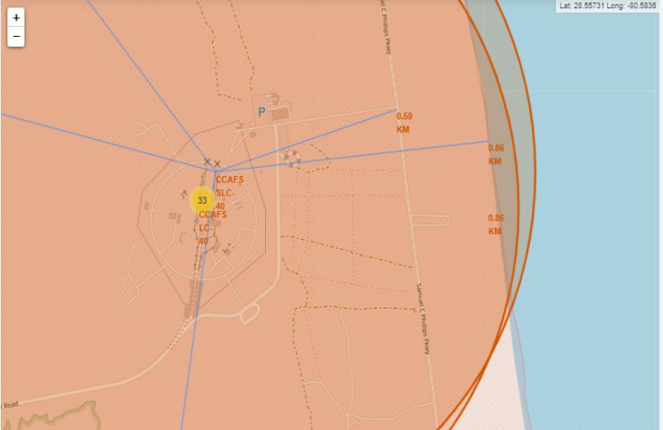
Near Launch Sites
Observations:
The launch sites also maintain a certain distance from the cities.

Slide 37

Section 4

Slide 38
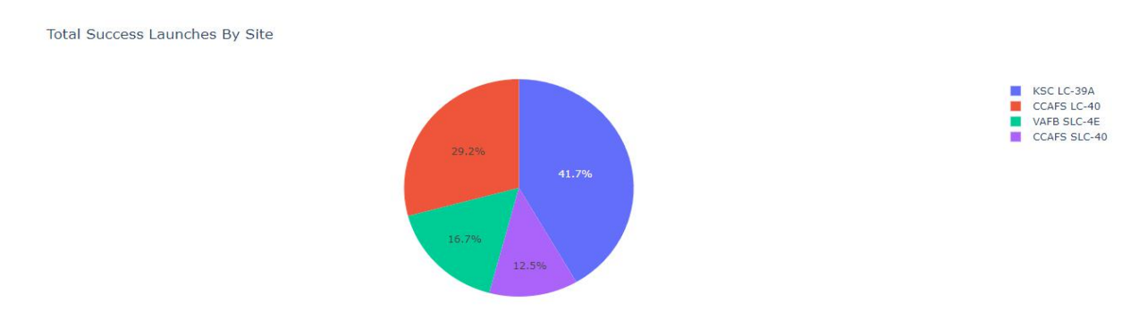
Successful Launches By Site

Slide 39
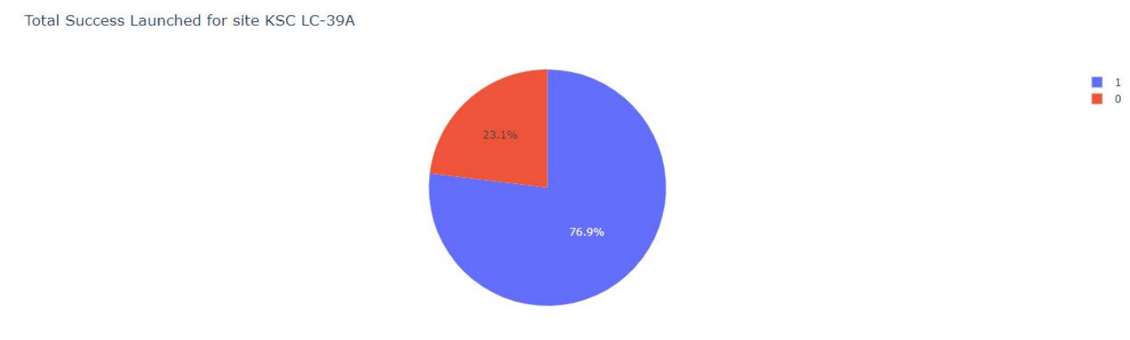
Site With Highest Success

Slide 40
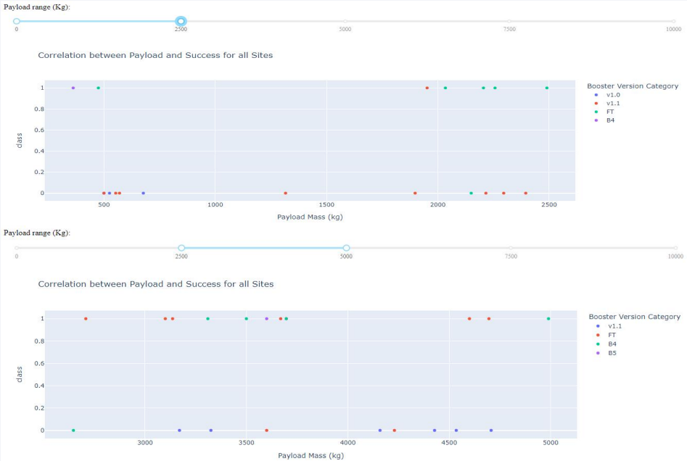
Payloads vs Launch Outcome

Slide 41

Section 5

Slide 42
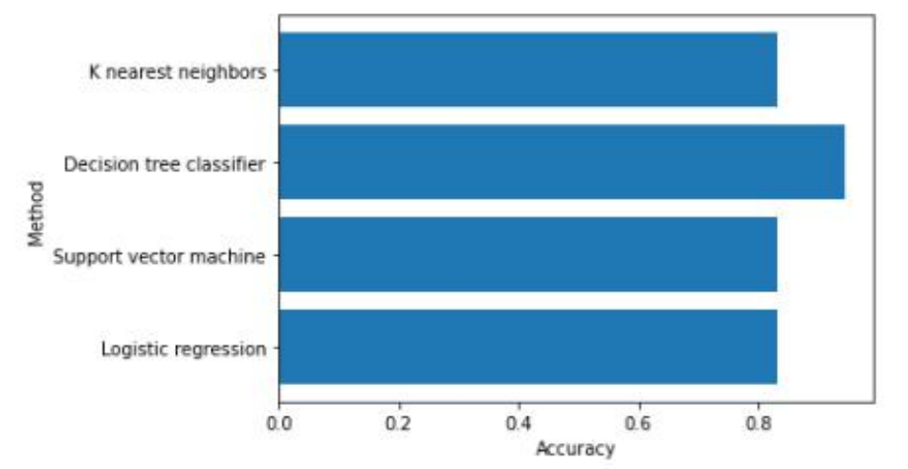
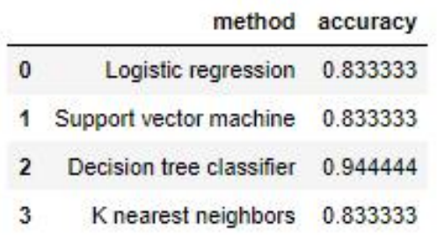
Classification Accuracy

Slide 43
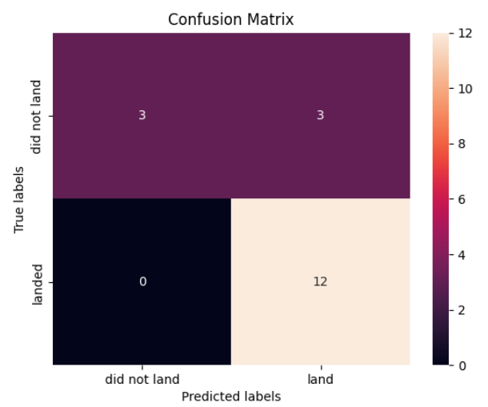
Confusion Matrix
Observations:
The model predicted 12 successful landings when the True label was successful (True Positive) and 3 unsuccessful landings when the True label was failure (True Negative).
The model also predicted 3 successful landings when the True label was unsuccessful landing (False Positive).
The model generally predicted successful landings.

Slide 44
Conclusions
The analysis showed that there is a positive correlation between number of flights and success rate as the success rate has improved over the years.
There are certain orbits like SSO, HEO, GEO, and ES-L1 where launches were the most successful.
Success rate can be linked to payload mass as the lighter payloads generally proved to be more successful than the heavier payloads.
The launch sites are strategically located near highways and railways for transportation of personal and cargo, but also far away from cities for safety.
The best predictive model to use for this dataset is the Decision Tree Classifier as it had the highest accuracy with 94%.

Slide 45


